Slide 1
Assignment deadlines reminder
March 31st – web service programming tutorial (10%)
15% - Hot topic study journal – 3 tasks
Task 1 – March 26th
Task 2 – April 2nd
Task 3 – April 9th
10% - Exercises - Case study – April 16th

Slide 2
Hot topic study – 15% → Task 2 (5%)
Find information online about the benefits of applying service orientation in the chosen domain/industry
List the most common benefits in a table
benefits | Short description of the benefit | Link to the website where the benefit is described/mentioned

Slide 3
COMP3017 Service Computing

Slide 4

Module Seven: Hot topics in Service Computing - Cloud -

Slide 5
Topic 3: Cloud Stakeholders, Cloud Standardization, Cloud Computing Reference Architecture

Slide 6
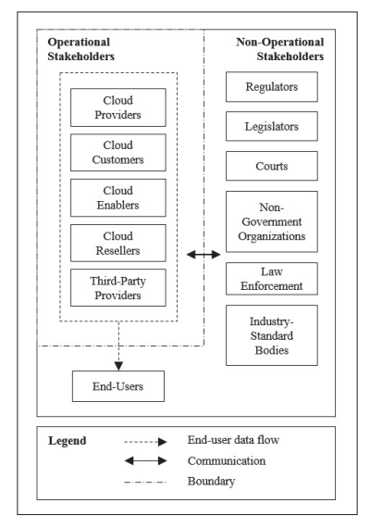
Cloud Stakeholders

Slide 7
Importance of foundational standards
Two foundational standards that deal with vocabulary and reference architecture
ISO/IEC 17788:2014 “Information technology — Cloud computing — Overview and vocabulary”
ISO/IEC 17789:2014 “Information technology — Cloud computing — Reference architecture”.
Essential for developing other standards

Slide 8
Cloud Computing Reference Architecture

Slide 9
Cloud Computing Reference Architecture
Defines the basic building blocks—architectural elements and their relationships—which make up the cloud
Cloud computing roles
Cloud computing activities
Cloud computing functional components and their relationships

Slide 10
Standards describing CCRA
Before 2010, cloud computing reference models were proposed by multiple cloud organizations, vendors, and federal agencies
Example: 2010 – CCRA developed by IBM
In 2011 CCRA developed by NIST was published
The team from NIST surveyed and completed an initial analysis of existing cloud computing reference models and developed a neutral model of architectural concepts
In 2014 ISO together with IEC published an international standard describing CCRA

Slide 11
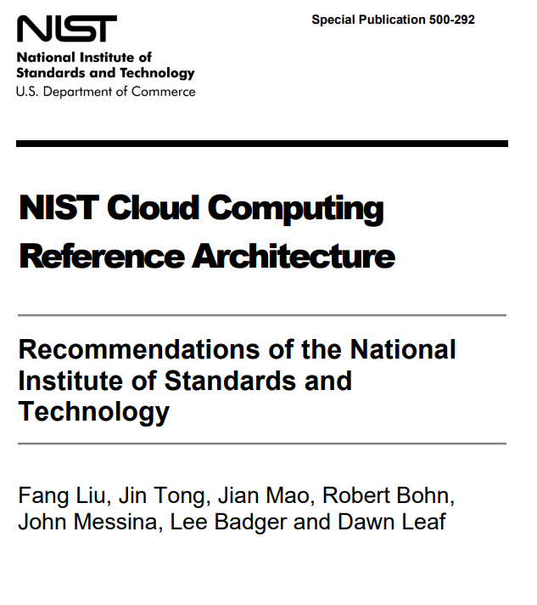
CRRA developed by NIST
NIST - National Institute of Standards and Technology
SP 800-145: The NIST Definition of Cloud Computing
SP 800-146: Cloud Computing Synopsis and Recommendations
SP 500-292: NIST Cloud Computing Reference Architecture

Slide 12
CCRA developed by ISO
ISO/IEC 17789:2014, Cloud computing – Reference architecture
diagrams and descriptions of how various aspects of cloud computing relate to one another and includes cloud computing roles, activities and functional components and their relationships.
This standard was last reviewed and confirmed in 2021.

Slide 13
Service deployment models
A cloud infrastructure may be operated in one of the following deployment models
public cloud
private cloud
community cloud
hybrid cloud
The differences are based on how exclusive the computing resources are made to a Cloud Consumer

Slide 14
Public cloud
A cloud in which the cloud infrastructure and computing resources are made available to the general public over a public network
Owned by an organization selling cloud services, and serves a diverse pool of clients

Slide 15
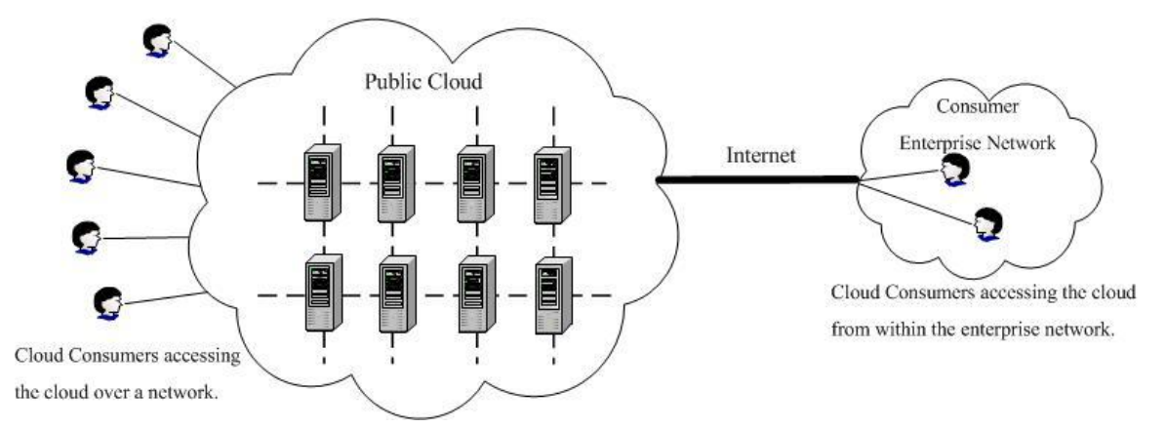
Public cloud

Slide 16
Private cloud
A cloud that gives a single Cloud Consumer’s organization the exclusive access to and usage of the infrastructure and computational resources
It may be managed either by the Cloud Consumer organization or by a third party
on-site private clouds - hosted on the organization’s premises
outsourced private clouds - outsourced to a hosting company

Slide 17
On-site private cloud
Hosted on the organization’s premises

Slide 18
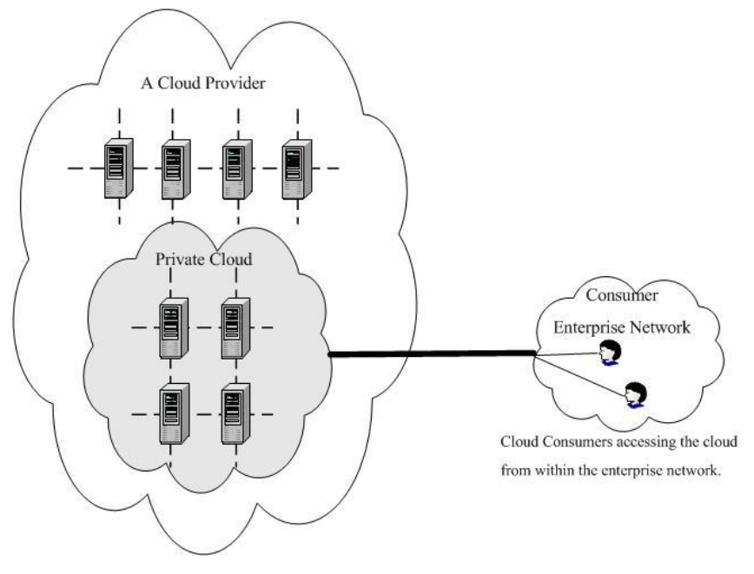
Outsourced private cloud
Outsourced to a hosting company

Slide 19
Summary (1)
Standardization of cloud computing
Standards ensure that goods or services produced in a specific industry come with consistent quality
Many standards and specifications related to Cloud Computing have been developed by standards developing organizations
Foundational standards that deal with vocabulary and reference architecture are essential for developing other standards

Slide 20
Summary (2)
Cloud Computing Reference Architecture
Cloud Computing Reference standard defines the basic building blocks—architectural elements and their relationships—which make up the cloud
Cloud computing reference models were proposed by multiple cloud organizations and standard setting bodies

Slide 21
Summary (3)
Cloud computing standards and laws in China
China has developed a number of standards and laws that regulate the adoption of cloud computing technology in different aspects (security, privacy, financial and others)
Chinese parties collaborate with international standard setting bodies

Slide 22
Topic 4:Virtualization

Slide 23
Intended learning outcomes
After completing this topic, you will be able to:
Discuss system, network and storage virtualization and outline their role in enabling the cloud computing system model

Slide 24
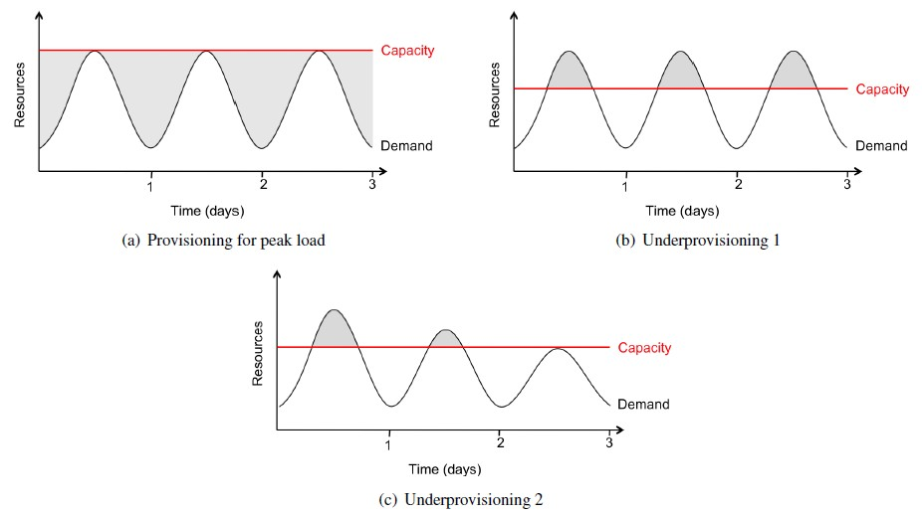
Resource Provisioning problems - Company's/Customer's View
Resource Wastage
Unserved Requests
Loss of Customers
Big Headache

Slide 25
Resource Provisioning problems - Company's/Customer's View
Resource Wastage
Unserved Requests
Loss of Customers
Big Headache

Slide 26
Resource Provisioning problems - Company's/Customer's View
Resource Wastage
Unserved Requests
Loss of Customers
Big Headache

Slide 27

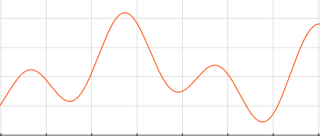
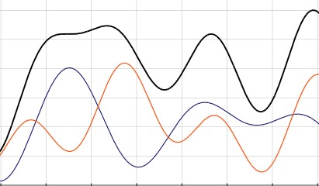
Resource Provisioning – Data Center/Cloud Provider's View
2000 2050
0
0
Company ­ BLUE
Company ­ RED
Consider the Data Center or a Cloud provider that needs to serve 2 customers with the following needs:
Peak demand of the “Company BLUE” customer is 2000 machines
Peak demand of the “Company RED” customer is 2050 machines
3000
0
Cloud Provider

Slide 28
Resource Provisioning – Data Center/Cloud Provider's View
2000 2050
0
0
Company ­ BLUE
Company ­ RED
3000
For the Data Center, or the Cloud provider, to serve these 2 customers, there is a need to provide 4050 machines
0
Cloud Provider

Slide 29
Resource Provisioning – DataCenter/Cloud Provider's View
2000 2050
0
0
Company ­ BLUE
Company ­ RED
3000
However, the peak demands of the two customers is not at the same time
Some machines can be used to serve both customers at different times
0
Cloud Provider

Slide 30
Resource Provisioning – Data Center/Cloud Provider's View
2000 2050
0
0
Company ­ BLUE
Company ­ RED
3000
The black line shows the number of machines needed to meet the demand from the both customers at any given time
Maximum 3000 machines are needed to meet the demand
0
Cloud Provider

Slide 31
Resource Provisioning – DataCenter/Cloud Provider's View
2000 2050
0
0
Company ­ BLUE
Company ­ RED
3000
- Charge for 4050 machines, work with 3000
- Good business
- Computing as a service or utility
0
Cloud Provider

Slide 32
Cloud Computing requirements
Scaling infrastructure on demand within minutes or even seconds, instead of days or weeks, thereby avoiding under­utilization (idle servers) and over­utilization
Accessing resources and services needed to perform functions with dynamically changing needs

Slide 33
Virtualization definition (1)
Virtualization is the creation of a virtual (rather than physical) version of something, such as
an operating system
a server
a storage device
or network resources.
It hides the physical characteristics of a resource from users, instead showing another abstract resource.

Slide 34
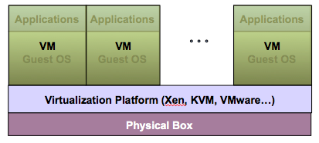
Virtualization Architecture
Multiple virtual machines (VMs) can run on a single physical system
Guest OS assumes complete control of the underlying hardware
Virtualization architecture provides this illusion through virtualization platform

Slide 35
Virtual machine
A Virtual machine (VM) is a software implementation of a machine (i.e. a computer) that executes programs like a real machine
VM is an isolated runtime environment (guest OS and applications)

Slide 36
Host vs guest
Host (Target)
The primary environment - the machine on which the virtual machine is created
Guest (Source)
The virtualized environment

Slide 37
Virtualization platform
Other names
Hypervisor
Virtual machine manager (VMM)
Virtual machine monitor (VMM)
Virtualization manager
A software layer which provides virtualization:
Allows multiple Guest OS to run simultaneously on a single physical host
Provides hardware abstraction to the running Guest OSs and efficiently multiplexes underlying hardware resources.

Slide 38
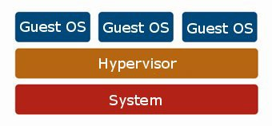
Virtualization – resource sharing and isolation
Each guest OS appears to have the host's processor, memory, and other resources all to itself
However, the hypervisor is actually controlling the host processor and resources
Allocates what is needed to each operating system in turn
Makes sure that the guest operating systems cannot disrupt each other
Hardware

Slide 39
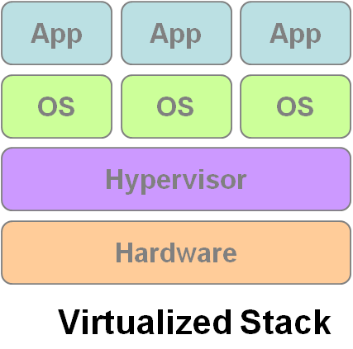
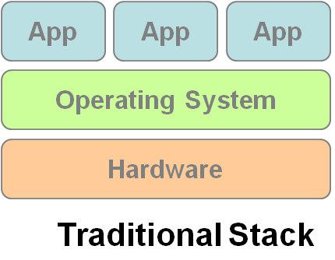
Virtualization
VM1
VM2
VM3

Slide 40
Benefits of Virtualization
Sharing of resources helps cost reduction
Isolation: Virtual machines are isolated from each other as if they are physically separated
Encapsulation: Virtual machines encapsulate a complete computing environment
Hardware independence: Virtual machines run independently of underlying hardware
Portability: Virtual machines can be migrated between different hosts.

Slide 41
Virtualization in Cloud Computing
Cloud computing takes virtualization one step further:
You don’t need to own the hardware
Resources are rented as needed from a cloud
Various providers allow creating virtual servers:
Choose the OS and software each instance will have
The chosen OS will run on a large server farm
Can instantiate more virtual servers or shut down existing ones within minutes
You get billed only for what you used

Slide 42
Importance of Virtualization in Cloud Computing
Cloud can exist without Virtualization, although it will be difficult and inefficient
Cloud makes notion of “Pay for what you use”, “infinite availability- use as much you want”
These notions are practical only if we have
lots of flexibility
efficiency in the back-end
This efficiency is readily available in Virtualized Environments and Machines
Virtualization is the foundation which supports cloud computing

Slide 43
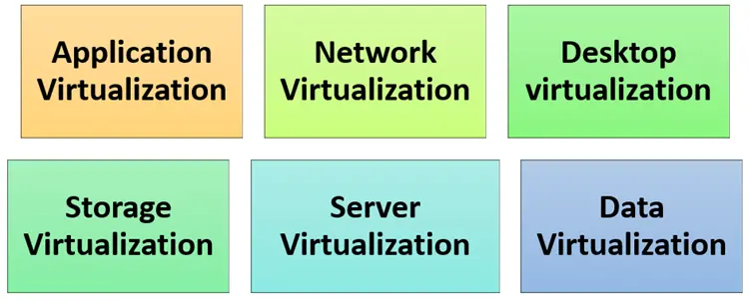
Types of Virtualizations

Slide 44
Types of Virtualizations

Slide 45
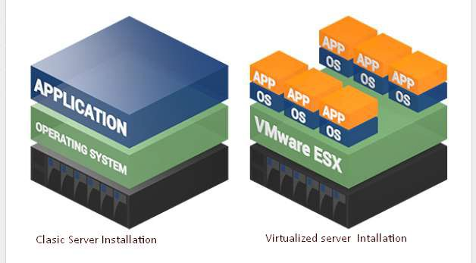
Server Virtualization
When the hypervisor is directly installed on the server system

Slide 46
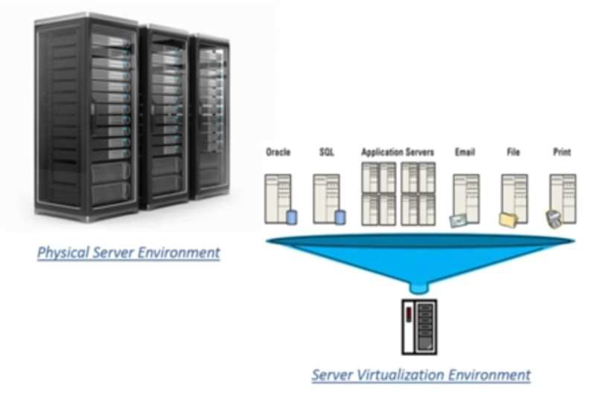
Server Virtualization
A single physical server can be divided into multiple servers
on the demand basis
for balancing the load

Slide 47
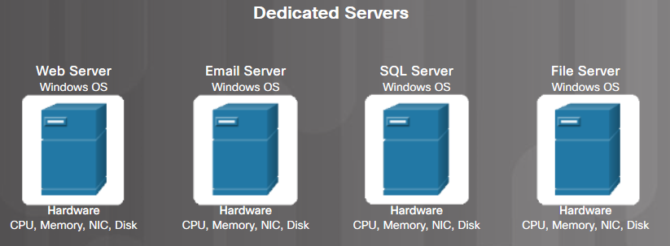
Traditional Server Deployment
Traditionally, organizations delivered applications and services using powerful dedicated servers.
These dedicated servers are equipped with large amounts of RAM, powerful CPUs, and multiple large storage devices.
Disadvantages include: wasted resources, single-point of failure, and server sprawl.

Slide 48
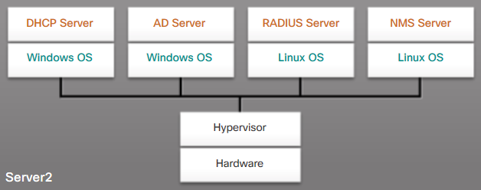
Server Virtualization
Server virtualization takes advantage of idle resources to reduce the number of servers required

Slide 49
Advantages of Server Virtualization
Better use of resources
Less space required
Less energy consumed
Reduced cost
Faster server provisioning
Maximize server uptime
Improved disaster recovery
Support for legacy systems

Slide 50
Hipervisor Types
Type 1 – Bare metal
Hipervisors run directly on the host's hardware as a hardware control and guest operating system monitor
Type 2 – Hosted
Hipervisors are software applications running within a conventional operating system

Slide 51
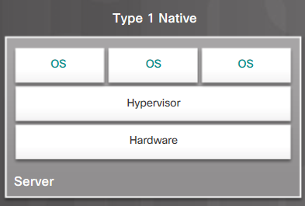
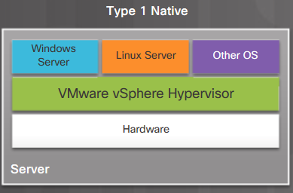
Type 1 Hypervisors
Type 1/bare metal/native
Typically used with server virtualization
For example, they are used in data centers and cloud computing
Run directly on the hardware of a host, and manage the allocation of system resources to VMs

Slide 52
Type 1 Hypervisors
Type 1/bare metal/native
Typically used with server virtualization
For example, they are used in data centers and cloud computing
Run directly on the hardware of a host, and manage the allocation of system resources to VMs

Slide 53
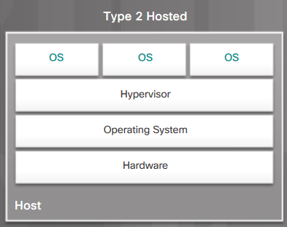
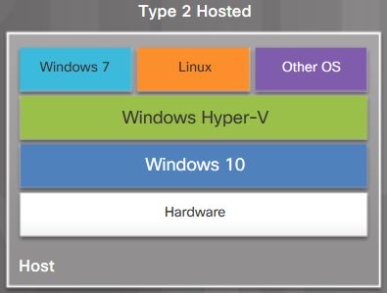
Type 2 Hypervisors
Type 2/hosted
Commonly used with client-side virtualization.
Type 2 hypervisors work with the host computer to create and use multiple VMs

Slide 54
Type 2 Hypervisors
Type 2/hosted
Commonly used with client-side virtualization.
Type 2 hypervisors work with the host computer to create and use multiple VMs

Slide 55
Containerization
OS level virtualization + Application level virtualization = containerization

Slide 56
Containers
The containers are basically a fully functional and portable cloud or non-cloud computing environment surrounding the application and keeping it independent from other parallelly running environments
Individually each container simulates a different software application and runs isolated processes by bundling related configuration files, libraries and dependencies
But, collectively multiple containers share a common OS Kernel
In recent times, the containerization technology has been widely adopted by Amazon Web Services, Microsoft Azure, Google Cloud Platform, and IBM Cloud

Slide 57
Types of containers
OS containers
Apps containers

Slide 58
Container management, orchestration, clustering
Container orchestration or container management is mostly used in the context of application containers
Implementations providing such an orchestration include Kubernetes and Docker swarm and others

Slide 59
Kubernetes
Kubernetes is an open-source container orchestration system for automating software deployment, scaling, and management
Google originally designed Kubernetes (announced in mid-2014)
The Cloud Native Computing Foundation now maintains the project

Slide 60
Kubernetes distributions
Various vendors offer Kubernetes-based platforms or infrastructure as a service (IaaS) that deploy Kubernetes
Alibaba Cloud ACK (Alibaba Cloud Container Service for Kubernetes)
Amazon EKS (Elastic Kubernetes Service)
DigitalOcean managed Kubernetes Service
Google GKE (Google Kubernetes Engine)
IBM Cloud Kubernetes Services
Microsoft AKS (Azure Kubernetes Services)
Mirantis K0s
Oracle Container Engine for Kubernetes
Red Hat Openshift
SUSE Rancher Kubernetes Engine (RKE)
VMware Tanzu

Slide 61
Docker
Docker is a set of platform as a service (PaaS) products that use OS-level virtualization to deliver software in packages called containers

Slide 62


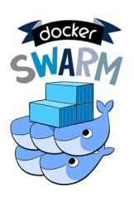
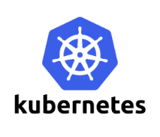

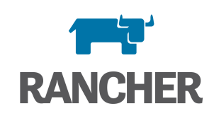
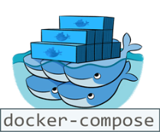
Container Technologies
Containers
Light-weight OS/application-layer virtualization
Isolation: From other Apps and OS
Portability: Binary, Data, Config, Logs
Container Orchestration
Deploy and manage complex services
Scalability and high-availability

Slide 63
Example - CERN core technologies running in containers
Container-based Service Deployment
Containerize and distribute CERN storage services and deploy them on any cloud
CERN - the European Organization for Nuclear Research
a European research organization that operates the largest particle physics laboratory in the world
ScienceBox
The container-based version of CERN services
EOS
CERNBox
SWAN

Slide 64


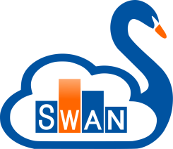
Containerized CERN Technology
Boxed – Scalable Storage Backend for Cloud and HPC (high performance computing)
- Self-contained, Docker-based package with:
EOS: Disk Storage for LHC+physics data, and CERNBox
CERNBox: Cloud Sync&Share for Science
SWAN: Platform for Interactive Data Analysis in the Cloud
CERN IT-ST
CERN IT-ST
CERN IT-ST + EP-SFT

Slide 65
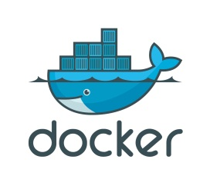
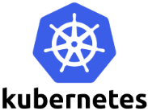
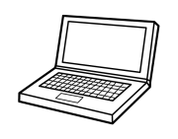

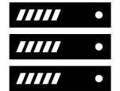
Containerized CERN Technology
ScienceBox – Self-contained, Docker-based package with:
+
+
One-Click Demo Deployment
Production-oriented Deployment
Single-box installation via docker-compose
No configuration required
Download and run services in 15 minutes
https://github.com/sciencebox
Container orchestration with Kubernetes
Scale-out storage and computing
Tolerant to node failure for high-availability

Slide 66
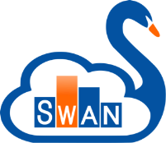
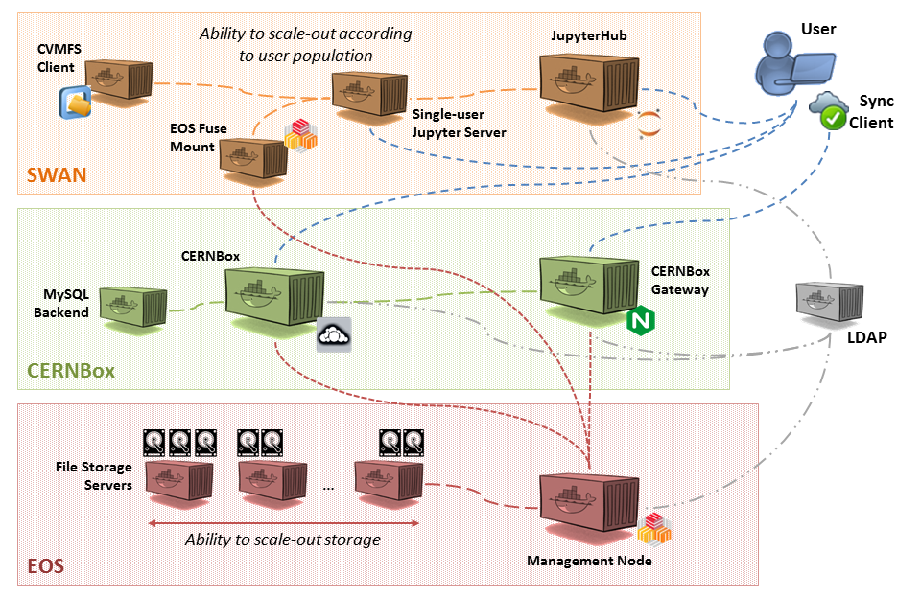


ScienceBox Architecture
SWAN: Platform for Interactive Data Analysis in the Cloud
CERNBox: Cloud Sync&Share for Science
EOS: Disk Storage for LHC+physics data, and CERNBox
https://sciencebox.web.cern.ch/sciencebox/

Slide 67



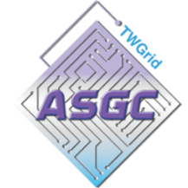

Use Cases for ScienceBox
EU Project Up to University (Up2U)
Simplified try-out and deployment for peers
Australia's Academic and Research Network (AARNET)
Joint Research Centre (JRC), Italy
Saint Petersburg State University, Russia
National Research Center “Kurchatov Institute”, Russia
Disposable deployment for testing and development within IT-ST and EP-SFT groups at CERN
Up2University: Educational Platform with Sync/Share, Peter Szegedi

Slide 68
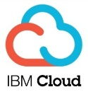

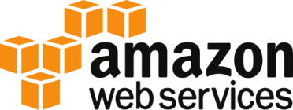


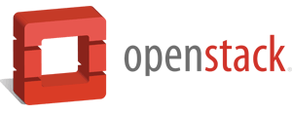
Deployment on Private and Public Clouds
Single-box deployment running on multiple clouds:
Amazon Web Services
Helix Nebula Cloud (IBM, RHEA, T-Systems)
OpenStack Clouds (CERN, GRNet, PSNC)
Your own laptop! (CentOS, Ubuntu)
Production-oriented deployment with Kubernetes
OpenStack at CERN
Poznań Supercomputing and Networking Center (PSNC)

Slide 69
Summary
Discuss virtualization and outline its role in enabling the cloud computing system model

Slide 70
Topic 5: Private cloud platform construction

Slide 71
Intended learning outcomes
After completing this topic, you will be able to:
Use the cloud computing virtualization technologies
Construct private cloud platform
Be aware of private cloud disadvantages

Slide 72
Private cloud
A cloud computing environment in which all hardware and software resources are dedicated exclusively to, and accessible only by, a single party

Slide 73
Private cloud vs Public cloud (1)
Private cloud
dedicated to the needs and goals of a single organization
Public cloud
Delivers services to multiple organizations

Slide 74
Private cloud vs Public cloud (2)
Private cloud delivers similar advantages to public cloud, including scalability and self-service, but through a proprietary architecture
Private cloud is a single-tenant environment

Slide 75
Single-tenant environment
Tenant - the organization using the cloud
In single-tenant environment the tenant does not share resources with other users

Slide 76
Single-tenant environment
Tenant - the organization using the cloud
In single-tenant environment the tenant does not share resources with other users
What does it mean that the resources are not shared?

Slide 77
How are the resources hosted in private clouds?

Slide 78
Example
Let’s consider an example of an enterprise with multiple business units
Business need: data storage
Resource: private data center

Slide 79
How can the resources be hosted and managed?

Slide 80
How can the resources be hosted and managed?
Option 1 – private data center
Organization's on-premises data center
Owned and hosted on organization’s premises
Managed by organization

Slide 81
How can the resources be hosted and managed?
Option 2 – public cloud
Hosted by another organization on shared resources

Slide 82
How can the resources be hosted and managed?
Option 3 – private cloud
Hosted on resources dedicated to the organization (not shared)

Slide 83
Constructing a private cloud
Cloud infrastructure
components needed for cloud computing
the basic elements of cloud infrastructure are the same whether you have a private cloud, public cloud, or hybrid cloud.
Operating system+ a variety of bare-metal, virtualization, or container software that abstract, pool, and share scalable resources across a network.
The IT staff that is equipped to manage private cloud environments

Slide 84
How can the resources be hosted in private clouds?

Slide 85
On-Premise/Internal private cloud
Motivation
Better utilization of resources
Maintain full control
The private cloud is based on resources and infrastructure already present in an organization's on-premises data center
The organization/enterprise hosts a cloud environment internally

Slide 86
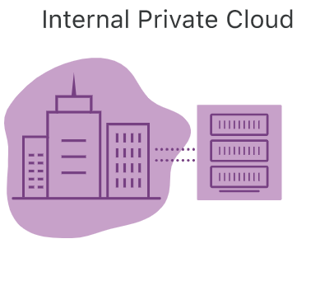
On-Premise/Internal private cloud
In this model, who is
Cloud provider/service provider?
Customer/user/cloud tenant?

Slide 87
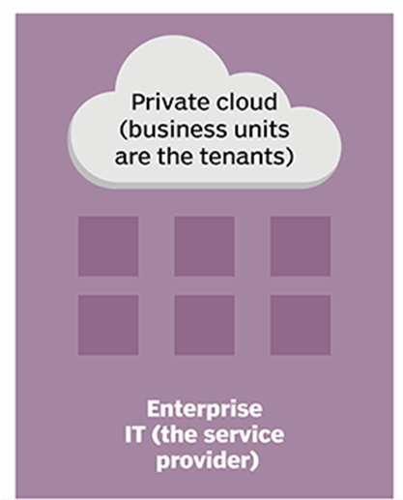
On-Premise/Internal private cloud
Infrastructure is owned and managed by the enterprise’s own IT team
Enterprise IT becomes the service provider
Enterprise’s business units use resources hosted in the private cloud
Business units are cloud tenants

Slide 88
On-Premise/Internal private cloud benefits
Very secure
internally hosted and managed by an organization’s internal IT department
the organization has complete control over the security, configurations, and scalability of its servers

Slide 89
On-Premise/Internal private cloud benefits
Higher cost
Can include the cost of purchasing and installing new hardware and software and the cost of managing it (which may involve hiring additional IT staff.)
Limited flexibility
once an organization invests in hardware and software for its private cloud, adding capacity or new capabilities requires additional purchases

Slide 90
How are the resources hosted in private clouds?

Slide 91
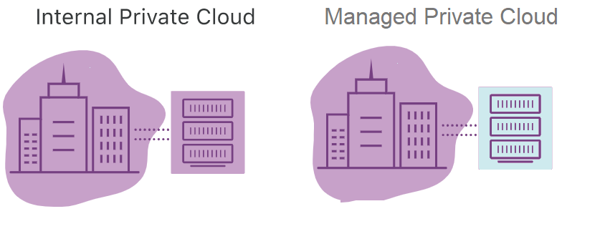

Slide 92
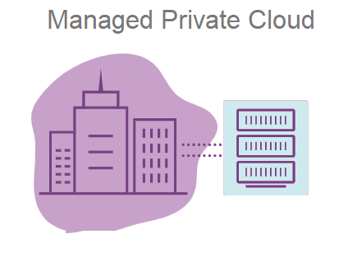
Managed
Responsibility for managing and maintaining the infrastructure is outsourced to a third-party service provider.
The physical hardware
usually resides in the service provider’s data center
vendors also offer management services for infrastructure located in an enterprise’s own data center
The provider maintains every part of the cloud for the enterprise, including the deployment of additional services like identity management and storage.
A good alternative for companies that don't have the resources to run private cloud systems on their own

Slide 93
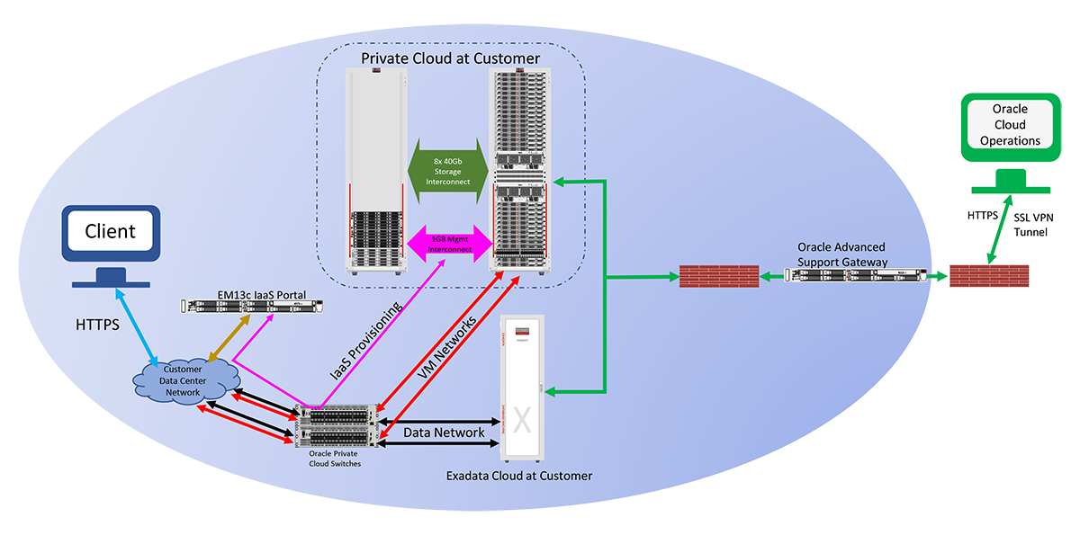
Example - Oracle Private Cloud at Customer
Infrastructure managed by Oracle but deployed inside inside customer own data centers

Slide 94
Architecture of Oracle Private Cloud at Customer
A web-based self-service management interface gives the customer interactive access to service administration functions
Oracle monitors and manages the infrastructure components
the physical compute node hardware
network switches
power distribution units (PDUs)
Oracle Integrated Lights Out Manager interfaces (ILOMs)
the storage
These operations are performed remotely by Oracle using the Oracle Advanced Support Gateway

Slide 95
Manage private cloud example – Atlantic.Net
Atlantic.Net's Managed Virtualization
provides a managed private cloud hosting solution
utilizes enterprise-level hardware running industry standard hypervisor software

Slide 96
Services offered in managed private cloud
System Environment
Clustering
VM Provisioning
System Updates
Replication and Failover
Advanced Certifications
Advanced Monitoring
Additional VM Services
Managed Private Cloud Infrastructure

Slide 97
System Environment
Up-to-OS management and support
Active administration of host server resources, including CPU, network, and hard disk utilization

Slide 98
Clustering
Offers the ability to migrate VM to another host server in case of system failure or load balancing between servers
Allows for redistribution of Virtual Machines amongst multiple host servers and the ability to configure a shared storage node to provide VM Hypervisor management and automated failover of a clustered computing node
This is done by increasing memory/CPU per computing node, since VM hard disks are located on a shared storage

Slide 99
VM Provisioning
VM creation, cloning, and removing
Initial private networking setup and VLAN tagging (to segment traffic between individual VMs)
A self-service portal enables customers to start, stop, and console in to any configured VM

Slide 100
System Updates
Prior to updating the host server, each new update is reviewed and tested to ensure that there are no issues with the system
Any necessary restarts will be scheduled
Hyper-V deployments make use of cluster aware updating, ensuring 100% uptime while updating each node in the cluster.

Slide 101
Replication and Failover
Virtual Machine replication is designed to provide cross-node fault tolerance by increasing the necessary storage, memory, and CPU requirements for a separate dedicated computing node

Slide 102
Advanced Certifications
Microsoft Certified Professionals, and Red Hat Enterprise Linux Certified Engineers on staff to assist with all VM design, configuration, and deployment

Slide 103
Advanced Monitoring
Service provider will ensure the hardware, virtualization hypervisor, and all VMs are always functioning properly
If the customers encounter an issue relating to OS-level or system configuration, our certified professionals can assist you under a consulting agreement

Slide 104
How are the resources hosted in private clouds?

Slide 105
Hosted private cloud

Slide 106
Hosted private cloud
The private cloud is based on new, separate infrastructure, which is provided by a third-party organization
The environment where infrastructure is both hosted and managed by the cloud provider itself

Slide 107
How hosted private cloud works
The cloud provider allocates a particular server to a particular organization
The server’s resources are not shared among other organizations
The organization only uses the resources and can access them as per the demand
The cloud provider is responsible for managing, updating, and configuring the hardware, software, and network

Slide 108
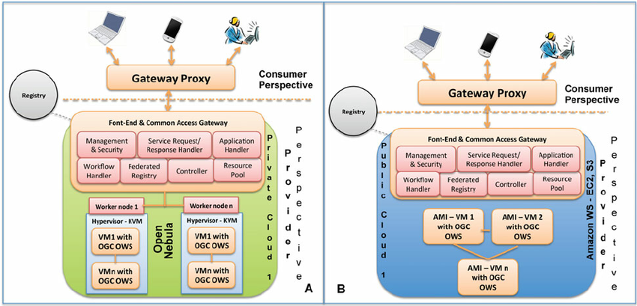
Hosted private vs public cloud

Slide 109
Hosted private vs public cloud (2)
From the customer perspective both options have some similarity- the service provider configures the network, maintains the hardware and updates the software
However, in a hosted private cloud environment, the servers are not shared with other organizations

Slide 110
Hosted private cloud benefits
Hosted private cloud vendors offer cloud servers in their own data centers and are also responsible for security management
Users get access to
additional resources
a support team
high-demand scalability options
a user-friendly dashboard to assist in server management

Slide 111
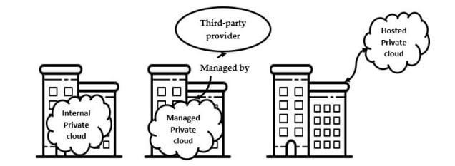
Internal vs Managed vs Hosted

Slide 112
How are the resources hosted in private clouds?

Slide 113
Virtual private cloud
A secure private cloud that is hosted remotely by a public cloud provider
The single-tenant environment is enabled solely using virtualization software

Slide 114
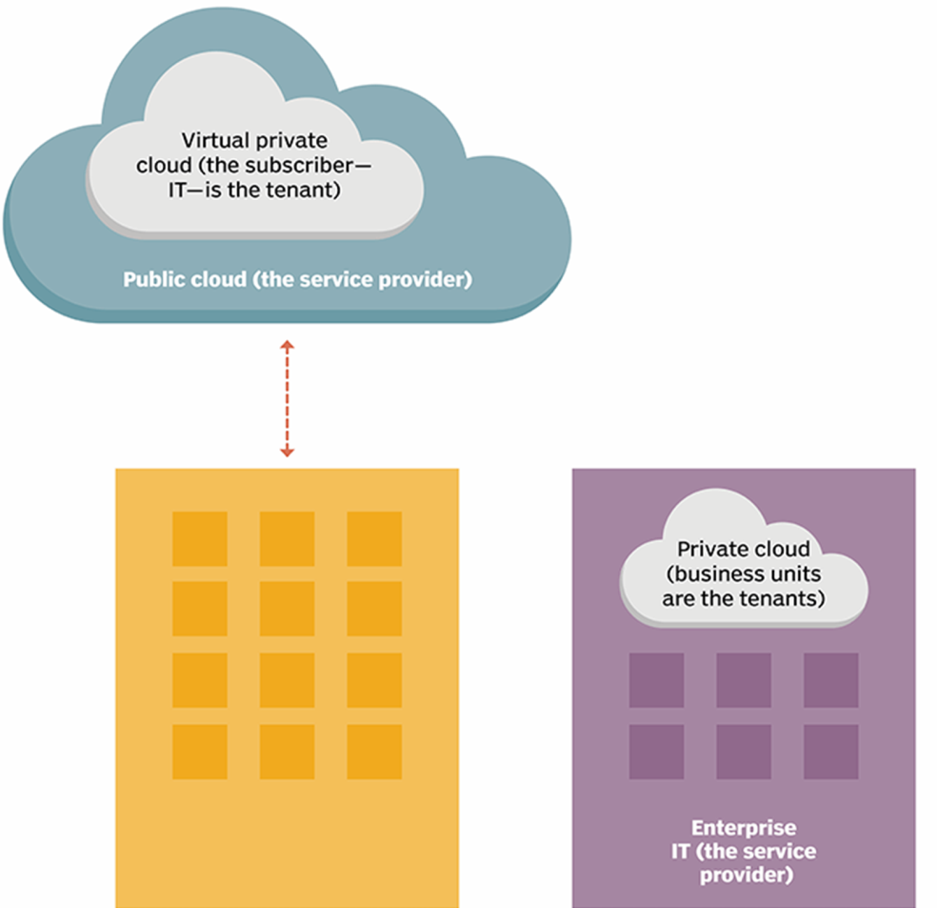
Virtual private cloud
A walled-off environment within a public cloud that allows an organization to run their workloads in isolation from every other user of the public cloud
Even though the server is shared by other organizations, the virtual logic ensures that a user's computing resources are private

Slide 115
Virtual private cloud benefits
VPC customers can benefit from the public cloud’s
Resource availability
Scalability
Flexibility
Cost-effectiveness
Retaining much of the security and control of private cloud
The ability to define and control a logically isolated space in the public cloud
Offers the private cloud’s enhanced security within a multi-tenant environment

Slide 116
How to create a virtual private cloud - example
VMware vCloud® Air™ Virtual Private Cloud OnDemand
Create an Account
Create a Virtual Machine
View and Monitor Resource Usage

Slide 117
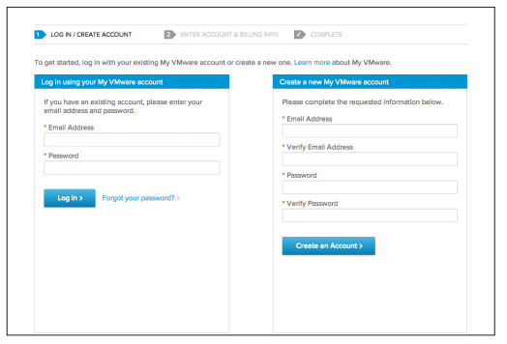
Create an account
a browser
a credit card

Slide 118
Create a Virtual Machine
When you log in to Virtual Private Cloud OnDemand the first time, a virtual data center named “VDC1” is automatically created with a routed network and gateway
A virtual data center is an environment in which virtual machines are stored, deployed, and operated
You can create one or more virtual data centers to expand your capacity limits exponentially and to organize resources into more-manageable chunks.
You can change the name of a virtual data center or delete it (and its associated virtual machines).

Slide 119
Create a Virtual Machine
To create your first virtual machine, simply click Create Your First Virtual Machine, and a wizard walks you through an easy two-step process:
Select a virtual machine
Select your desired resources

Slide 120
Select a Virtual Machine
Select a predefined template
Create an original virtual machine

Slide 121
Predefined template
Select a predefined template
from the VMware Public Catalog - an operating system and application catalog of commonly used, preconfigured workloads
from a list of your catalogs that have been uploaded under My Catalog

Slide 122
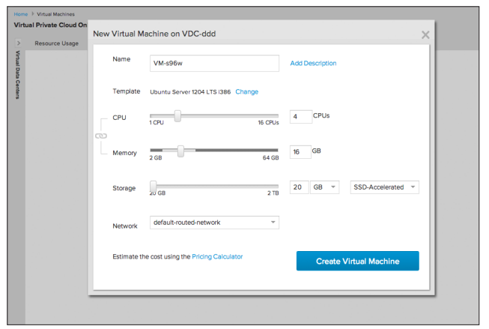
Select desired resources
Use the wizard’s slide scale to select your desired CPU, memory, storage, and network connection
You can adjust the CPU, memory, and storage resources of any virtual machine on the fly
Simply select the virtual machine you want to change and select Edit Resources from the Actions menu.

Slide 123
Create an original virtual machine
If you don’t want to create a virtual machine based on a template, you can create an original virtual machine in VMware vCloud Director®
Select Create My Virtual Machine from Scratch, which routes you to create a vSphere vApp™ and its virtual machines

Slide 124
View and Monitor Resource Usage
You can view resource usage data
for all virtual machines in a virtual data center
for specific virtual machines
Data is aggregated to display
monthly totals for storage usage
hourly totals for vCPU, vRAM, public IP addresses, and license usage
You can view resource usage by
month to date
the past 24 hours
the past hour
Enables you to pay for only the resources you use, on a per-minute, metered basis

Slide 125
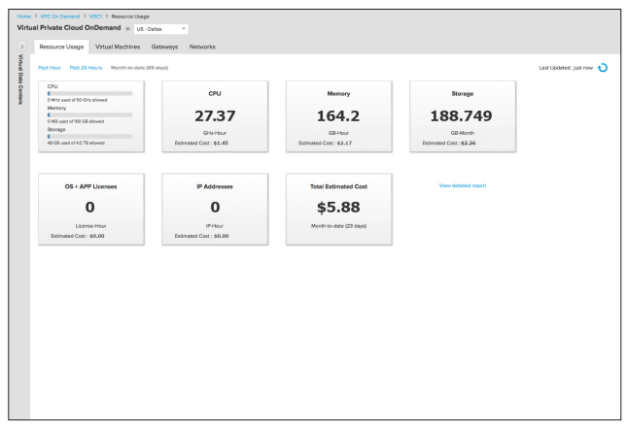

Slide 126
Types of private clouds
Virtual
Hosted
Managed
On-premise/Internal
All private clouds offer an isolated environment
Different types of private clouds are classified into categories based on how they are hosted and how much management they receive from the provider

Slide 127
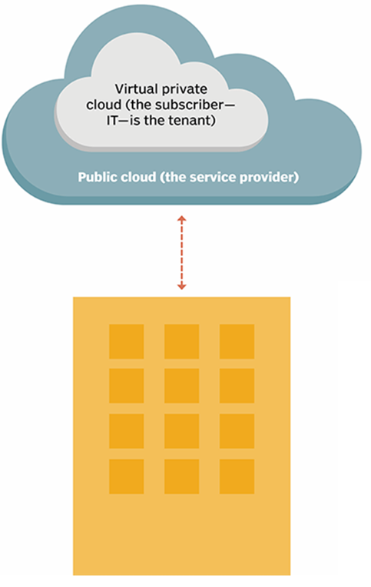
Private cloud types

Slide 128
Types of private clouds

Slide 129
Constructing a private cloud
Cloud infrastructure
components needed for cloud computing
the basic elements of cloud infrastructure are the same whether you have a private cloud, public cloud, or hybrid cloud.
Operating system+ a variety of bare-metal, virtualization, or container software that abstract, pool, and share scalable resources across a network.
The IT staff that is equipped to manage private cloud environments

Slide 130
Private cloud - a virtualized pool of resources
To enable multiple workloads to run on the same physical server, we need to virtualize the resources
We will use virtualization software to achieve that

Slide 131
Example - setting up a virtual machine server

Slide 132
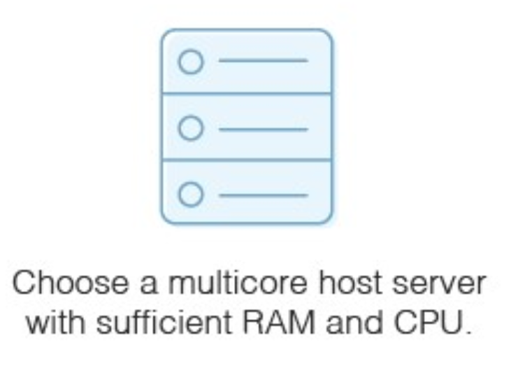
Physical hardware
Physical hardware with appropriate resources
The capacity of your physical host machine matters
each VM will need RAM and CPU

Slide 133
Storage
Necessary if you don’t have a storage area network for the virtual server images
The host server will need sufficient disks to hold this storage
SATA drives
SAS drives

Slide 134
Hypervisor
Use virtualization software (hypervisor) to set up virtual machine server
Hyper-V
Vmware
VirtualBox
Citrix XenServer
Hypervisor types
bare-metal hypervisors
installed directly on the hardware
may run slightly faster, but they’re a bit trickier to set up and use than a hosted hypervisor
hosted hypervisors
installed on an already-existing operating system installed on the host machine
Follow the instructions on the hypervisor itself to set up and provision a virtual server. Hosted hypervisors are much like any computer application because they have a setup wizard with easy instructions.

Slide 135
Configure Virtual Machines
Check the default values for the virtual machine to ensure it will suffice for your purposes
Choose
What guest operating system you want to run
Where the virtual machine’s files will be stored
The types of network connection you want to set up for the virtual machine
Decide whether to allocate all the disk space for the virtual machine when you create it, or whether you want it to take disk space dynamically as needed.
You can configure three types of virtual machine resources
Hardware it has access to
Power management operating system options
Resource configuration
CPU configuration
Hyperthreading
Disk settings
Memory

Slide 136
Example - setting up a virtual machine server

Slide 137
Private Cloud Solutions
Allow companies to architect a data center using software-defined networking (SDN) and virtualization (VMs)
Private cloud solutions come from
proprietary software developers like Microsoft, VMware, and Nutanix
enterprise-grade open source solutions available from Red Hat and others

Slide 138
VMware Private Cloud
VMware - a leading international cloud infrastructure company
provides virtualization solutions since 1998
VMware Private cloud - a virtualized pool of resources allocated on-demand
Private cloud is able to easily switch between virtual machines to keep everything running
It can also create endless virtual machines based on your underlying hardware

